Slide 1
Regional Storage Investment
Artúr Böröcz
Security of Supply Working Group GSE
Regulatory Expert, E.ON Földgáz Storage Zrt.
ENTSOG Workshop
Bruxelles, 22nd February 2011

Slide 2
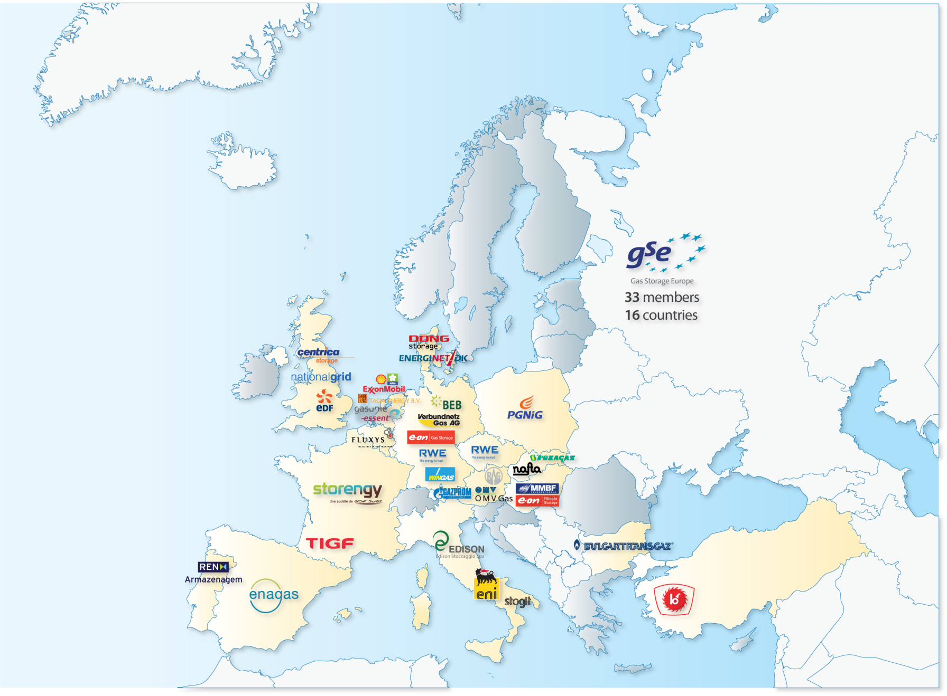
Gas Storage Europe
www.gie.eu
GSE represents:
33 Storage System Operators
110 storage sites in 16 countries
≈ 85% of Europe’s technical storage capacity

Slide 3
Agenda
1.
Market challenges and the role of natural gas storage
2.
Gas storages significantly increase the SoS
3.
Storage as a commercial tool
4.
The future of UGS: energy storage
5.
Factors that determine storage investments
6.
Potential cooperation between SSOs and TSOs

Slide 4
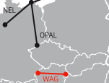
1. Market challenges and the role of gas storage
Market challenges
Role of gas storage
I
Local storage helps to manage temporary supply chain disruptions and LNG transit times
IV
II
Gas storage allows for optimisation of gas purchase decisions and helps to keep the competitivness of gas
Reduce
greenhouse
gas emissions
III
Gas storage protects customers from excessive short-term market price volatility , while the global demand for gas is increasing
Sustainability
Secure energy
supplies
Energy affordability
IV
Utilising expertise in storage to store energy and to balance volatility of renewable energy supply via CCGT flexibility
I
II
II
III
Notes:
Now – to come back to my earlier question: What will be the role of natural gas and the underground storage business in trying to achieve the EU‘s climate targets?
[Click]
As long as natural gas is needed in Europe's energy chain, underground gas storages facilities will provide the flexibility and security needed for gas volumes that are mostly imported from abroad. So storage has a role to play in ensuring price stability and preventing unreasonable price hikes.
[Click]
Moreover, natural gas enables more low-carbon power generation, and it provides a back-up for renewable energy sources.
And what‘s more, further underground storage capacities might help in solving the challenge of storing electrical energy.

Slide 5
2. Gas storages significantly increase the security of supply
50%
Austria
Slovakia
Hungary
40%
Bulgaria
Czech Republic
30%
France
Flexibility
Storage / Demand (%)
Germany
Denmark
EU-27 2030e
EU-27 2020e
20%
Romania
Italy
Storage/Imports = 25%
EU-27
10%
Poland
Netherlands
Spain
United-Kingdom
Ireland
Belgium,
Portugal,
Switzerland
0%
0%
20%
40%
60%
80%
100%
Imports / Demand (%)
Estonia, Finland,
Lithuania, Lux.
Security of Supply
Source: SG Equity Research / Eurogas / GSE 2008

Slide 6
3. Storage as a commercial tool
Type of spread
Example
Instrument used
Cross Regional
Buy at NBP Sell at TTF
Interconnectors
Cross Global
Buy at Henry Hub Sell at NBP
LNG
Time
Buy in summer Sell in winter
Storage
Cross Commodity
Buy at TTF Sell at APX
Power station
Storage is complementary to LNG in trading as it allows to exploit a different type of spread
New storage products allow traders to gain higher flexibility and thus better exploit time spreads. E.ON Gas Storage examples:
Day ahead Day ahead trade of withdrawal and injection services (Germany)
EFS + Withdrawal in summer period and injection in winter (Hungary)

Slide 7
4. UGS has a key role in the intelligent energy supply concept
Share of fluctuating renewable energy is increasing
Base load from conventional sources
Additional “smart” grids
Demand
Additional peak supply from gas power plants
Energy storage (power/gas/hydrogen)
Notes:
They key to new technologies in the field of storage is "flexibility“,
because there is an important difference between conventional energy supplies based on coal and nuclear and the renewable sources such as wind and solar in their ability to provide baseload power. While coal-fired power plants, for example, can run almost constantly throughout the year, power from wind is fluctuating on a daily and a seasonal basis.
In today’s generation portfolio gas-fired power plants already have the important role of balancing out peak demand, because they can be brought on line fairly quickly.
However, in a world moving towards more and more renewable energies, natural gas will not be able to render the entire flexibility. Grid expansions, demand side management and energy storage are also part of the solution. The exact contribution of each component depends on the type of transition scenario and particularly on the role of nuclear and coal.
From today’s perspective, pumped hydro and compressed air energy storage are the most suitable systems for power generation at large rates and quantities of several gigawatts. In the following, I will focus on energy storage in the subsurface.

Slide 8
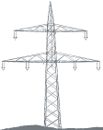
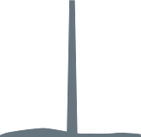
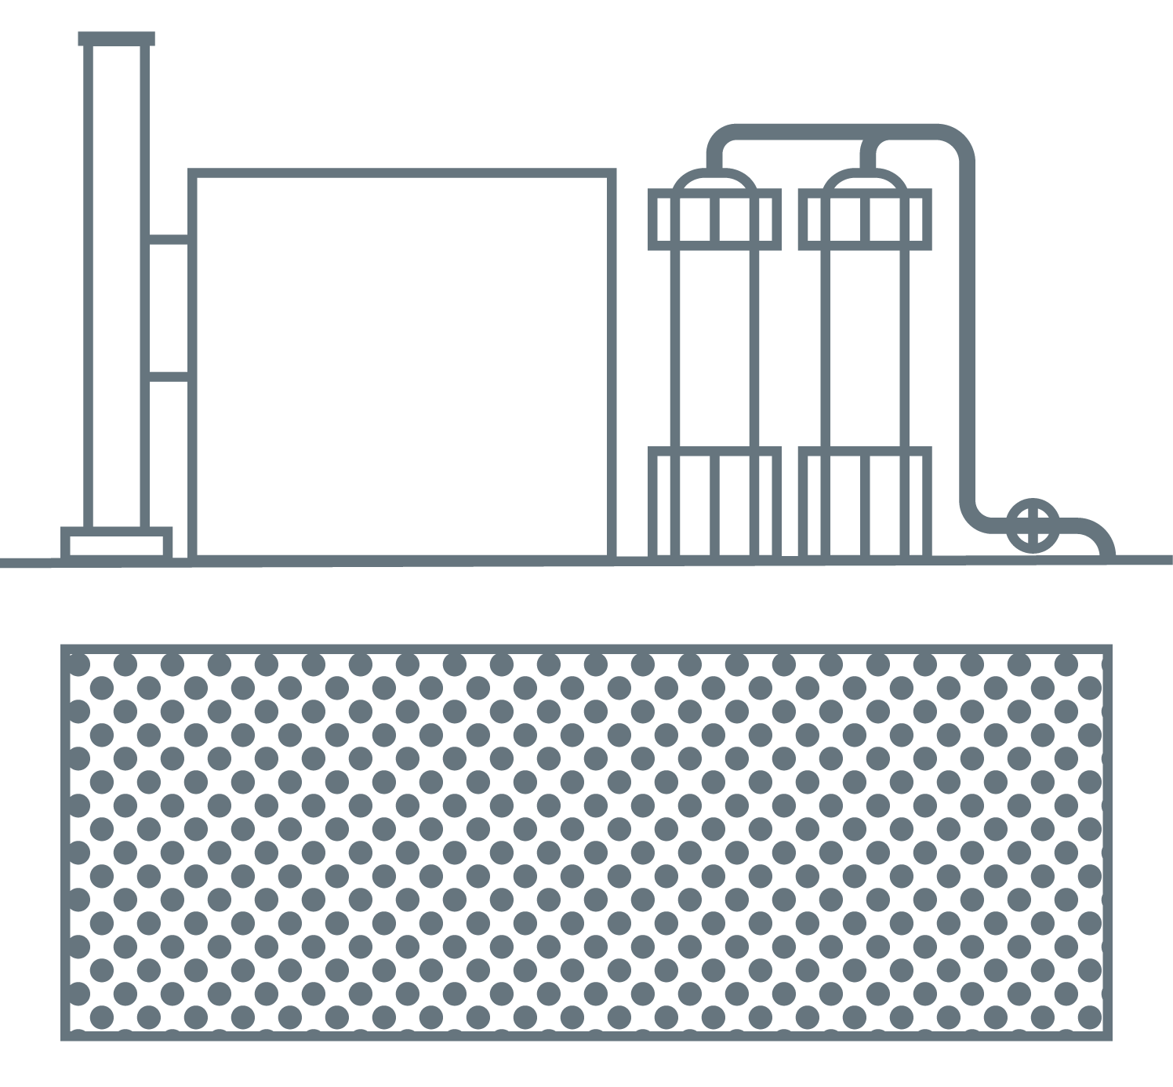
4. Future concept of integrated energy storage
Powergrid
Gas to Power
Gasgrid
Wind
Storage of Power
Underground Gas Storage
Sun
Nuclear
CCGT/ BHKW
Coal fired power plant
Electrolysis/
H₂
H₂
Methan
CH₄
CO2 separation
Synthetic Gas
„POWER TO GAS AND GAS TO POWER“
Notes:
Englische Version,
Dauer Animation 1 - Wind+Sonnenaufgang+Einspeicherung: 5s
Klick
Dauer Animation 2 – Wind flaut ab+Sonnenuntergang+Speicherentnahme: 5s

Slide 9
5. Factors that determine storage investments
Expected European storage capacity [bcm]
Appropriate regulatory framework is an essential condition of investments in gas storages
strategic storage is definitely damaging
choice of access regime should be market-oriented
negotiated TPA should be the preferred choice wherever market conditions allow :
best regime to facilitate investments
best regime to foster commercial creativity and provide best response to the demand
OECD Europe
30 * additional projects under consideration
132-156
119-131
104
15-27
87***
17
17
2010
2015
2020
2025
* GSE publication (2010)
Notes:
The chart shows briefly the existing storage capacities in 2010 as i.e. reported by GSE. They sum-up to ~87 bcm.
SSO´s reported of ~17 bcm additional WGV being already under construction and for commission between 2010 and 2015.
Further highly recommended projects are assumed for commission until 2020. This projects sum up with ~15 to 27 bcm additional working gas capacity, which then meets the European storage demand of ~110 to 120 bcm in a low gas demand scenario (EU demand 560 to 600 bcm @ 70 to 72% import dependency).
Furthermore possible projects with additional potential capacities of 26 to 31 bcm are reported, to enable the fulfillment of also a high EU gas demand scenario ( >650 bcm/a @ 75% import dependency).
All projects reported sum-up in total to ~70 bcm of possible additional WGV provided potentially by SSO´s for the European market. This figure is in line with the values reported by GSE.
Uncertainties in the future gas demand and potential impacts on long term investments due to non predictable or changing legal framework could highly influence commitments.

Slide 10
6. Potential cooperation between SSOs and TSOs
Products with reasonable cross boarder fees
Gas quality
Harmonizing measurement units
To aim at win-win position in regional sales
Common dialogue with decision makers
Network Code

